Slide 1
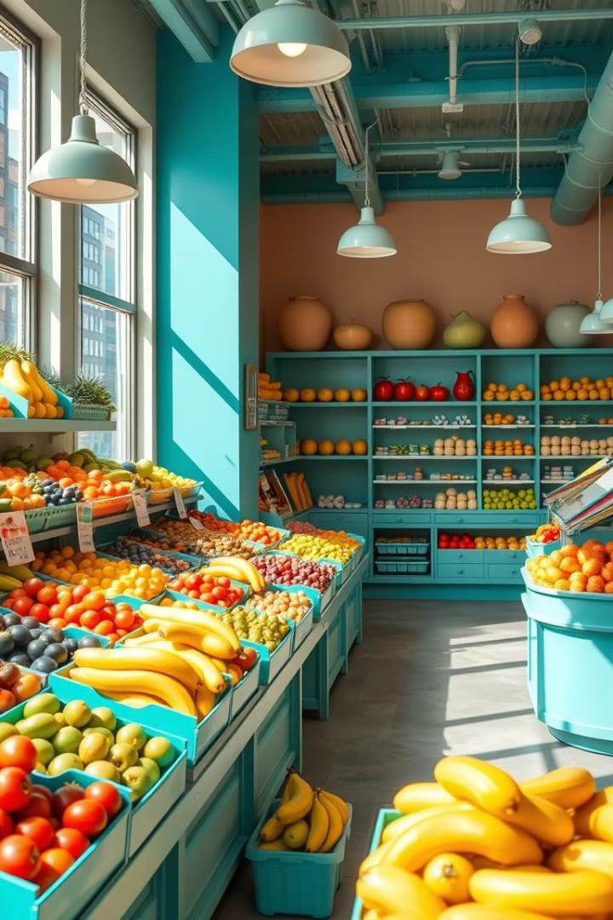
Fruit Shop GUI with Java Swing
Group No. : G-29
Roll No | Student Name
141 | Abhishek Devkatte
143 | Anuj Powar
145 | Vijay Kore
146 | Ranjit Dhapate

Slide 2
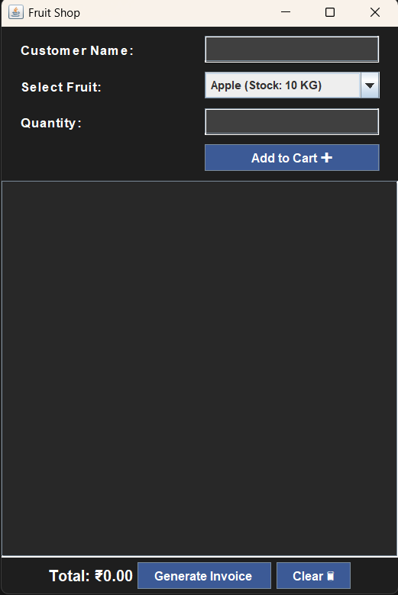
Core Functionality
Discover a user-friendly GUI to manage fruit shop inventory and sales.
Built with Java Swing ad efficient data structures for smooth operations.
Inventory Management
Add, remove, or update fruit stock with ease.
Fields include name, quantity, and price per unit.
Sales Processing
Calculate total costs and generate detailed receipts.
Input purchase quantities for accurate billing.

Slide 3
GUI Components
Main Window
Organized Layout
Data Display
User Inputs
JFrame serves as the primary application window.
JTable shows inventory using DefaultTableModel for dynamic updates.
JTextFields and JButtons manage interactions like adding fruits or selling stock.
JPanels separate inventory and sales sections for clarity.

Slide 4
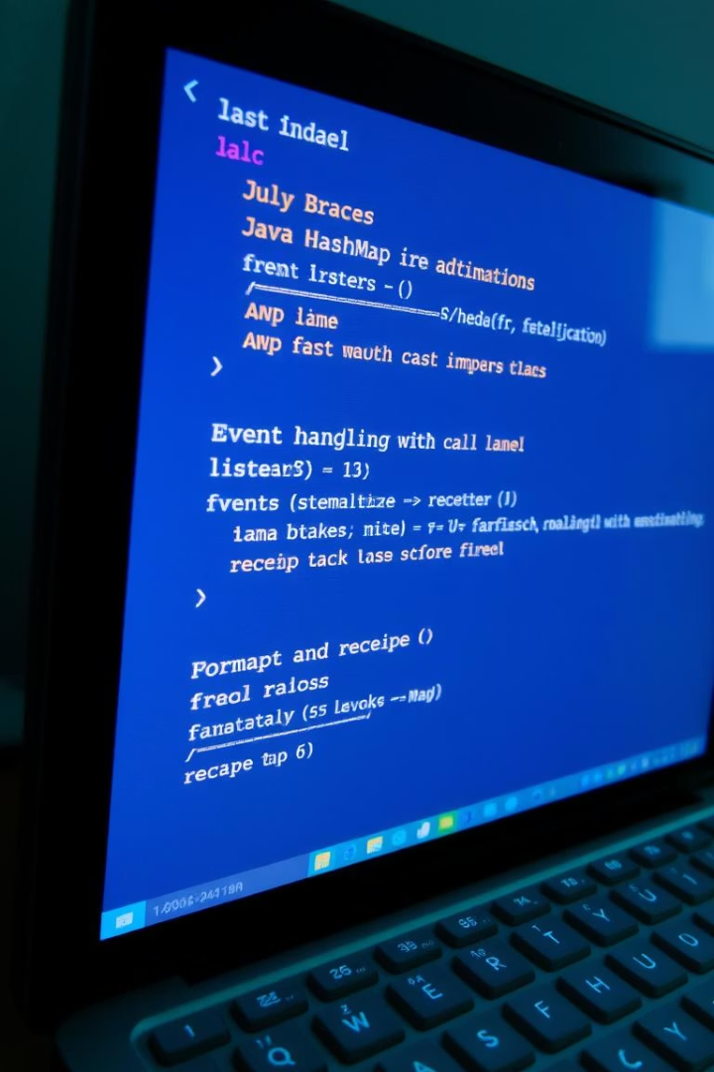
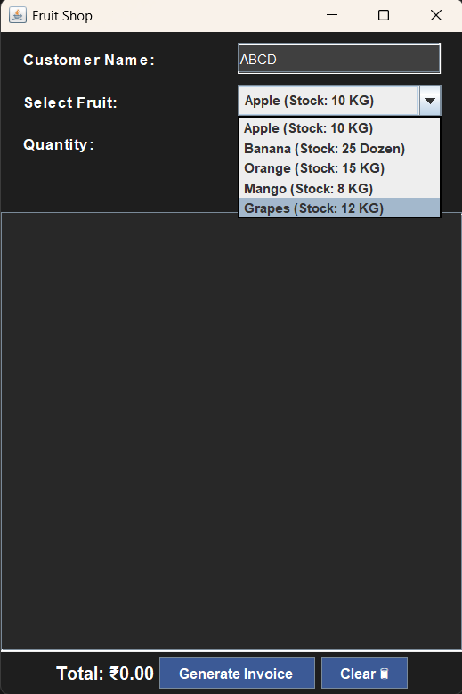
Implementation Details
Inventory Storage
Event Handling
ActionListeners process button clicks to update inventory or process sales.
Using HashMap with fruit name keys and Fruit object values for fast access.
Receipt Output
Formatted text area displays itemized receipts after each sale.

Slide 5
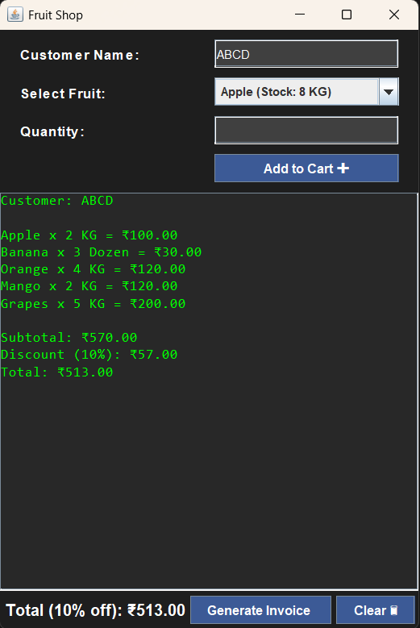
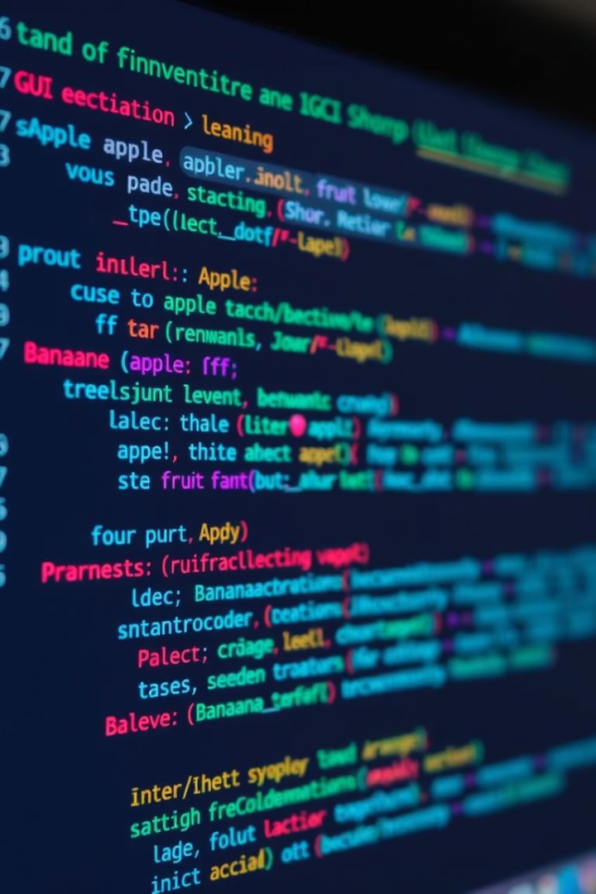
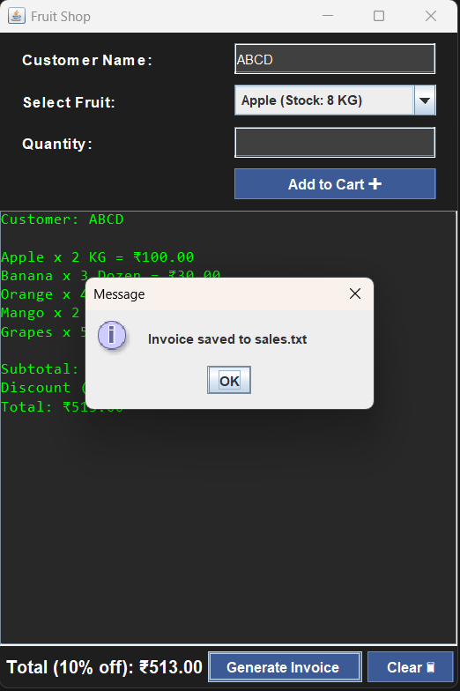


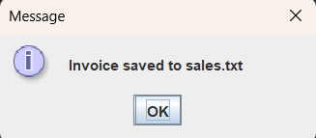

Code Snippets
Inventory Addition
`inventory.put("Apple", new Fruit("Apple", 100, 1.50));`
GUI Setup
Creating an Add Fruit button with action listener.
Event Handling
Override `actionPerformed` method to handle interactions.

Slide 6
Future Enhancements
Database Integration
Advanced Reporting
User Authentication
Improved GUI
Enhance look, feel, and responsiveness for better user experience.
Support for MySQL or PostgreSQL to persist data securely.
Generate sales reports and detect low stock automatically.
Role-based access control: admins and staff with different privileges.

Slide 7
THANK-YOU

